Slide 1
Introduction to Parallel C/C++
By Bismarck

Slide 2
Why C/C++?
Popular and highly available
Access to hardware resources
Highly efficient (if done right)
It’s not assembly

Slide 3
Main C/C++ Multi-threading offerings
 | Available in C | Architectures | Operating Systems | Abstraction
C++11 Threads | NO | ANY | ANY | LOW
POSIX Threads | YES | ANY | Unix-like | MIDDLE
OpenMP | YES | ANY | ANY | MAGICAL
Boost Threads | NO | ANY | ANY | MIDDLE
Windows Threads | YES | X86/X86_64 | Windows | VERY LOW
Solaris Threads | YES | SPARC,SPARC64, X86/X86_64 | Solaris | VERY LOW

Slide 4

Thread
The smallest sequence of programmed instructions that can be managed independently by a scheduler (Generally the OS).

Slide 5
Single-Threading
Multi-Threading
code
data
files
code
data
files
registers
registers
registers
registers
stack/heap
stack/heap*
stack/heap*
stack/heap*
Thread
Thread#0
Thread#1
Thread#2
*Heap management depends on OS/platform

Slide 6
Threads VS Processes*
 | Thread | Process
Domain | Perform related tasks | Independent
Resources | Small, shared state and resources | Large, private state and resources
Communication | Through shared resources | IPC: message queues, mmaps, etc.
Managed By | Programs | Operating System
*These are broad generalizations. Resource costs and features vary by implementation

Slide 7


Concurrency
Parallelism

Slide 8
Concurrency
Parallelism
CPU
CPU#0
Master Thread
CPU#1
fork
Time
fork
Thread #0
Thread #1
Thread #0
Thread #1
context switch
idle
join
context switch
…
…
join

Slide 9

Hyper-Threading: Virtual Threads

Slide 10
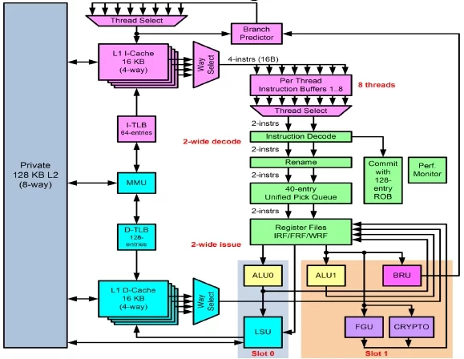
A SPARC-T4 Core

Slide 11
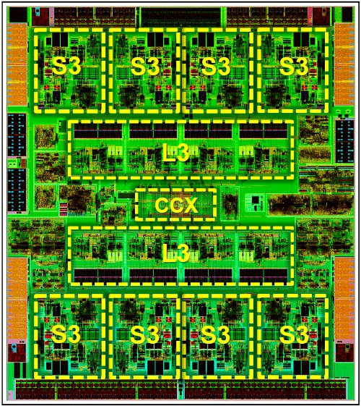
SPARC-T4
https://www.theregister.co.uk/2011/08/22/oracle_sparc_t4_hot_chips/

Slide 12
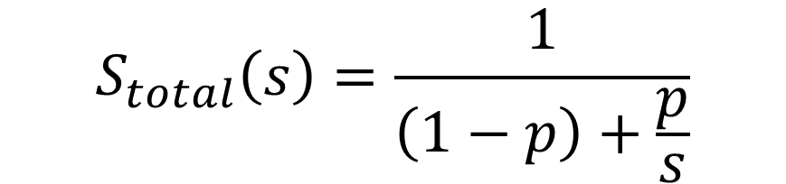
Amdahl’s Law: Choosing your speedups wisely
$$S_{total}\left(s\right)=\frac{1}{\left(1−p\right)+\frac{p}{s}}$$
S = Total speedup
s = Speedup of the part you sped up
p = Proportion of the execution time of the part you parallelized
total

Slide 13
Amdahl’s Law: Choosing your speedups wisely
A
B
Original Process
A
B’
Making B 5x faster
A’
B
Making A 2x faster
Time

Slide 14
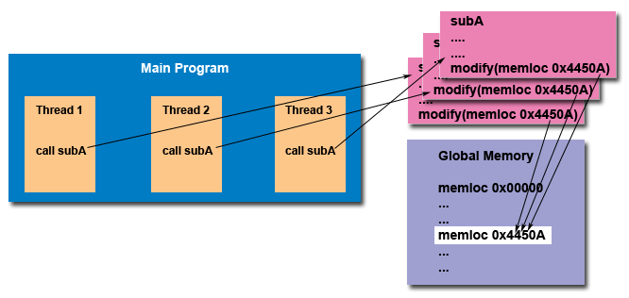
Thread Safeness
An application's ability to execute multiple threads simultaneously without "clobbering" shared data or creating "race" conditions.
From: https://computing.llnl.gov/tutorials/pthreads/

Slide 15
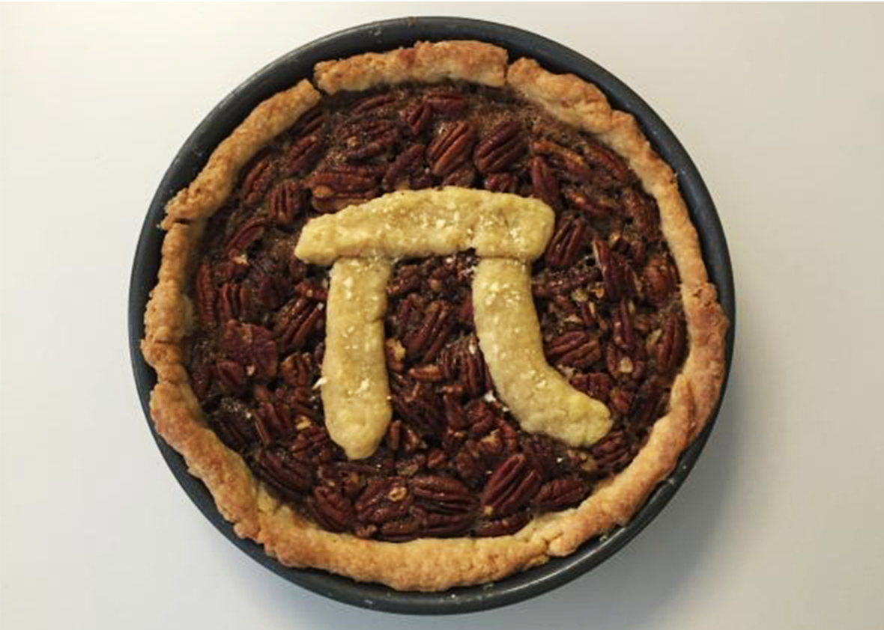
Sample Problem: Computing Pi

Slide 16

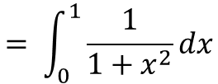

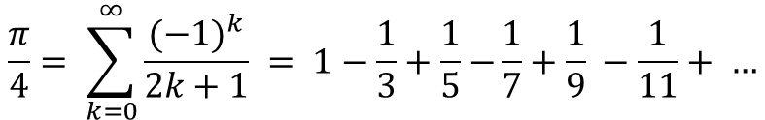
Sample Problem: Computing Pi
$$\frac{π}{4}= \tan^{−1}{(1)}$$
$$= \int_{0}^{1}{\frac{1}{1+x^{2}}dx}$$
$$\frac{π}{4}= \sum_{k=0}^{∞}{\frac{{(−1)}^{k}}{2k+1} = 1−\frac{1}{3}+\frac{1}{5}−}\frac{1}{7}+\frac{1}{9} −\frac{1}{11}+ …$$
https://proofwiki.org/wiki/Leibniz's_Formula_for_Pi

Slide 17
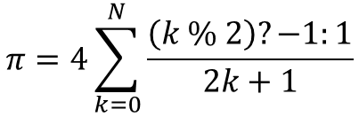
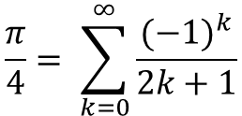
Sample Problem: Computing Pi
$$\frac{π}{4}= \sum_{k=0}^{∞}{\frac{{(−1)}^{k}}{2k+1}}$$
$$π=4\sum_{k=0}^{N}{\frac{\left(k \% 2\right)?−1:1}{2k+1}}$$
double pi(long long N) {
double sum = 0.0;
for (int k = 0; k < N; ++k) {
sum += (k % 2 ? -1.0 : 1.0) / (2 * k + 1);
}
return 4 * sum;
}
https://proofwiki.org/wiki/Leibniz's_Formula_for_Pi

Slide 18








Thread Scheduling:
$$1−\frac{1}{3}+\frac{1}{5}−\frac{1}{7}+\frac{1}{9} −\frac{1}{11}+ …$$
$$+\frac{1}{N−4}−\frac{1}{N−3}+\frac{1}{N−2}−\frac{1}{N−1}+\frac{1}{N}$$
…
CPU0
CPU1
CPU2
CPU0
CPU1
CPU2
CPU3
CPU0
CPU3
CPU0
$$1−\frac{1}{3}+\frac{1}{5}−\frac{1}{7}+\frac{1}{9} −\frac{1}{11}+ …$$
$$+\frac{1}{N−4}−\frac{1}{N−3}+\frac{1}{N−2}−\frac{1}{N−1}+\frac{1}{N}$$
CPU0
CPU1
CPU2
CPU3
$$1+\frac{1}{5}+\frac{1}{9} + …$$
$$+\frac{1}{N−4}+−\frac{1}{N−2}++\frac{1}{N}$$
CPU0-1
$$−\frac{1}{3}−\frac{1}{7} −\frac{1}{11}− …$$
$$−\frac{1}{N−3}−\frac{1}{N−1}$$
CPU2-3

Slide 19

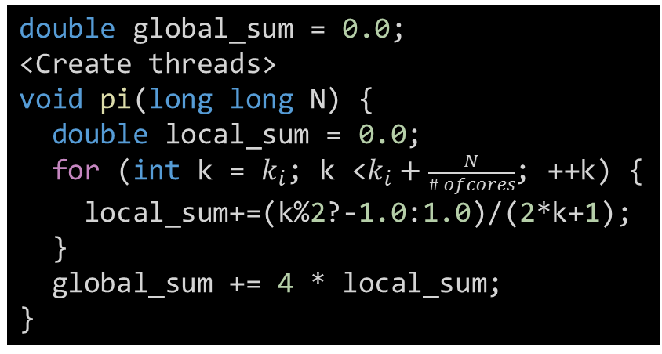

Data-Parallel Pi
$$1−\frac{1}{3}+\frac{1}{5}−\frac{1}{7}+\frac{1}{9} −\frac{1}{11}+ …$$
$$+\frac{1}{N−4}−\frac{1}{N−3}+\frac{1}{N−2}−\frac{1}{N−1}+\frac{1}{N}$$
k0
CPU0
k1
CPU1
k2
CPU2
k3
CPU3
double pi(long long N) {
double sum = 0.0;
for (int k = 0; k < N; ++k) {
sum+=(k%2?-1.0:1.0)/(2*k+1);
}
return 4 * sum;
}
double global_sum = 0.0;
<Create threads>
void pi(long long N) {
double local_sum = 0.0;
for (int k = $k_{i}$; k <$k_{i}+\frac{N}{\# ofcores}$; ++k) {
local_sum+=(k%2?-1.0:1.0)/(2*k+1);
}
global_sum += 4 * local_sum;
}

Slide 20

Variable Analysis: Private or Shared?
double global_sum = 0.0;
<Create threads>
void pi(long long N) {
double local_sum = 0.0;
for (int k = $k_{i}$; k <$k_{i}+\frac{N}{\# ofcores}$; ++k) {
local_sum+=(k%2?-1.0:1.0)/(2*k+1);
}
global_sum += 4 * local_sum;
}
Thread Private | Shared
local_sum | N
k | global_sum

Slide 21
Minimum Ingredients for Multi-threading
Thread creation method (forking)
Thread waiting method (joining)
Thread safeness mechanism (Mutex, semaphore, critical section, atomic op etc.)

Slide 22
Shell Commands to Know Your Environment
ulimit –a : Thread limitations
sar : Core utilization
mpstat : Core statistics
top : Running processes
kstat : Detailed architecture info

Slide 23
Portable Operating System Interface (POSIX)
A family of standards specified by the IEEE Computer Society for maintaining compatibility between operating systems.
Application programming interface (API), along with command line shells and utility interfaces, for software compatibility with variants of Unix and other operating systems.
-Wikipedia

Slide 24
Pthreads
Fork:
int pthread_create(pthread_t *thread, const pthread_attr_t *attr,
void *(*start_routine) (void *), void *arg);
Join:
int pthread_join(pthread_t thread, void **value_ptr);
Mutex:
int pthread_mutex_destroy(pthread_mutex_t *mutex);
int pthread_mutex_init(pthread_mutex_t *restrict mutex,
const pthread_mutexattr_t *restrict attr);
pthread_mutex_t mutex = PTHREAD_MUTEX_INITIALIZER;
int pthread_mutex_lock(pthread_mutex_t *mutex);
int pthread_mutex_trylock(pthread_mutex_t *mutex);
int pthread_mutex_unlock(pthread_mutex_t *mutex);

Slide 25
Open MP: Multi Threading Easy Mode
OpenMP (Open Multi-Processing) is an application programming interface (API) that supports multi-platform shared memory multiprocessing programming in C, C++, and Fortran
-Wikipedia

Slide 26
OpenMP
fork
mutex
#pragma omp parallel private(var1, var2) shared(var3){
<Thread code goes here>
}
join
Info Functions
int omp_get_num_procs(); // Number of cores
int omp_get_max_threads( ) // Number of threads available
int omp_get_num_threads( ); // Number of threads created
int omp_get_thread_num( ); // Current thread number

Slide 27
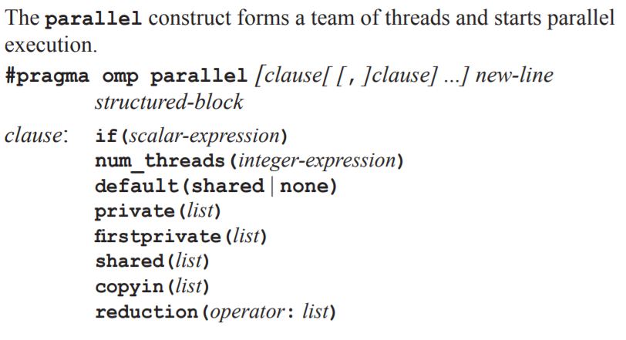
OpenMP pragmas
http://www.openmp.org/wp-content/uploads/OpenMP3.0-SummarySpec.pdf

Slide 28
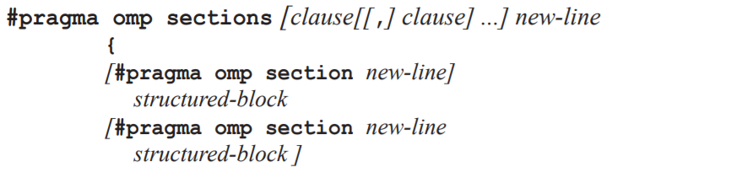
OpenMP pragmas
http://www.openmp.org/wp-content/uploads/OpenMP3.0-SummarySpec.pdf

Slide 29
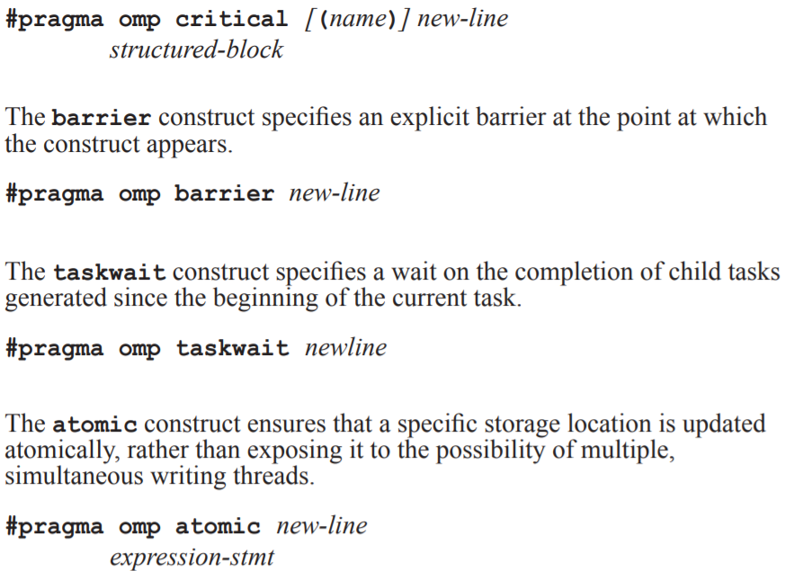

Slide 30
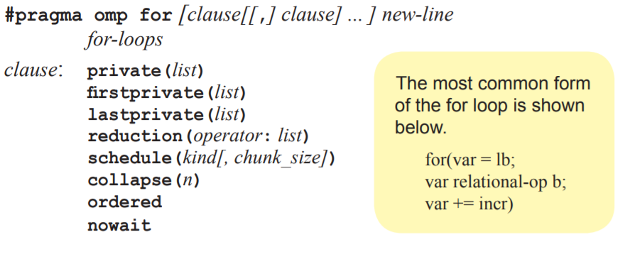
OpenMP pragmas
http://www.openmp.org/wp-content/uploads/OpenMP3.0-SummarySpec.pdf

Slide 31


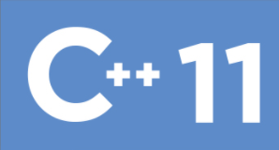

My Arbitrary Classification
POSIX
Ease of Use
Flexibility

Slide 32
OMP in the wilderness…

Slide 33

C++11 Exclusives: Futures & Promises
C++
ANSI C
C++11

Slide 34
C++11 Exclusives: Thread Pools, Futures & Promises
#include <iostream>
#include <future>
#include <thread>
int main(){
// future from a packaged_task
std::packaged_task<int()> task([]{ return pi(…); }); // wrap the function
std::future<int> f1 = task.get_future(); // get a future
std::thread task_thread(std::move(task)); // launch on a thread
// future from an async()
std::future<int> f2 = std::async(std::launch::async, []{ return pi(…); });
// future from a promise
std::promise<int> p;
std::future<int> f3 = p.get_future();
std::thread( [&p]{ p.set_value_at_thread_exit(9); }).detach();
std::cout << "Waiting..." << std::flush;
f1.wait();
f2.wait();
f3.wait();
std::cout << "Done!\nResults are: "<< f1.get() << ' ' << f2.get() << ' ' << f3.get() << '\n';
task_thread.join();
}

Slide 35
Other topics of interest
OMP Scheduling.
Thread affinity: Binding a thread to a specific core.
Using Single Instruction – Multiple Data (SIMD) Instructions.
Memory prefetching.
Architecture-specific optimizations.

